Slide 1

CHINESE MATERIA MEDICA
Tutorial 3

Slide 2
The Main Content:
Introduction: the Compendium of Materia Medica
Theory: Chinese Herbal Theory
Application: Hands-on activities using An Illustrated Chinese Materia Medica

Slide 3
Expected Outcomes:
Understand the importance of the Compendium of Materia Medica in the literature of TCM.
Be familiar with the general rules for combining herbs.
Know how to use the Compendium of Materia Medica as a handbook for your individual project.

Slide 4
THE COMPENDIUM OF MATERIA MEDICA
In the literature of TCM

Slide 5
What is Chinese Materia Medica?
Materia Medica is a branch of medical science that deals with the sources, nature, properties, and preparation of substances used for healing.
Chinese Material Medica is the foundation of TCM practice.
More than 6000 substance have been used and their effects documented and researched in the past four millennia. The major one is Chinese herbs.
Clinical practice and empirical results from millions of medical cases have created a data bank on individual substances as well as prescriptions of complex compounds.
Therefore, TCM has a very long history of researching and documenting substances used in the medical practice.

Slide 6
The Beginning: the Han Dynasty
The literary tradition of Chinese herbal knowledge also began in the Later Han dynasty with Shen Nong’s Herbal (Shen Nong Ben Cao Jing 神农本草经), also known as the Classic of the Materia Medica.
This text includes plant, animal, and mineral products, but plant products form the majority. Thus, Chinese pharmacological works are often termed Ben Cao, which literally means “of plant origin.”
The Classic of the Materia Medica is a summary of the clinical experience and the general knowledge of pharmacy prior to the Han dynasty.
365 Entries

Slide 7
The Development: the Tang and the Song
The Liang Dynasty: Tao Hong Jing, the Collection on Commentaries on the Shen Nong’s Herbal (Shen Nong Ben Cao Jing Ji Zhu), 730 entries
The Tang Dynasty: Su Jing et al., the Tang Materia Medica (Tang Ben Cao), which was China’s first illustrated materia medica, published officially, 844 entries.
The Song Dynasty: Tang Shen-Wei’s Materia Medica Arranged According to Pattern (Zheng Lei Ben Cao, A.D. 1082). After several revisions, in A.D. 1108 it was republished as the official pharmacopoeia of the Song dynasty, 1558 entries.

Slide 8
Why should we study Li’s Compendium of Chinese Materia Medica?

Slide 9
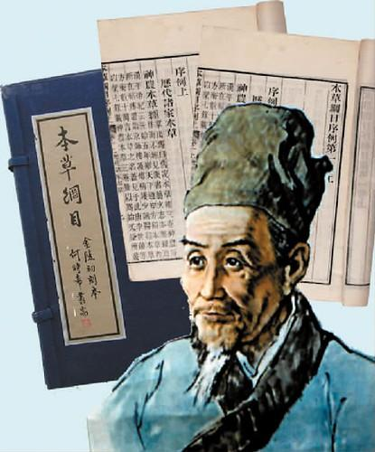
The Compendium of Materia Medica 本草纲目
During the Ming dynasty (A.D.1368-1644), Li Shi-Zhen 李时珍 compiled his famous Compendium of Materia Medica (Ben Cao Gang Mu), also called Grand Materia Medica.
As a physician and pharmacologist, Li systematized the folk experience of the previous generations by conducting his own investigation of medicinal substances.
Over the years, the Compendium has achieved worldwide recognition as a major contribution to the development of medicinal herbs and systematic botany.

Slide 10
The Compendium of Materia Medica 本草纲目
Li Shizhen completed the first draft of the text in 1578, after conducting readings of 800 other medical reference books and carrying out 30 years of field study.
The Compendium of Materia Medica is regarded as the most complete and comprehensive medical book ever written in the history of traditional Chinese medicine.
53 volumes, 1892 medicinal substances, including 1173 from plants, 444 from animals, and 275 from minerals.
Divided into 16 parts based on natural properties, i.e. water, fire, earth, metal and mineral, grass, cereal, vegetable, fruit, wood, cloth and utensil, insect, scale, crab shell, bird, animal and human beings.

Slide 11
CHINESE HERBAL MEDICINE

Slide 12
Chinese Herbal Theory
Chinese herbal theory, the theoretical base of Chinese Material Medica, has been established through long-term empirical clinical practice. It defines the character and functions of each herb, which include property, flavor, functional tendency, meridian channel tropism, and toxicity.
Chinese herbal theory is based on the theory of Yin-Yang and the Five Elements/Agents/Phases (Wu Xing), which are the foundation of Traditional Chinese Medicine. Thus, each herb is closely related to Zang-Fu organs and meridian channel systems.

Slide 13
(1) Properties
Properties of each herb refer to its temperature characteristics— cold, hot, cool, warm, and neutral.
These properties are derived from observing the therapeutic effects of a medical substance.

Slide 14
Question: What are the functions of substances in terms of their different properties?
Cold and cool substances:
clearing heat
purging Fire
removing toxicity
nourishing Yin
used for heat syndromes
Hot and warm substances:
warming the interior
supporting Yang
dispersing cold syndromes
Neutral substances:
used for either hot or cold syndromes

Slide 15
(2) Five Flavors
Five flavors refers to sour, bitter, sweet, pungent, and salty flavors of the substances.
Some substances may have a sixth, bland flavor as well.
Different flavours represent different functions.
Substances with the same flavor may have similar functions.
Pungent, sweet, and bland belongs to Yang 辛甘淡属阳
Sour, bitter, and salty belongs to Yin 酸苦咸属阴
Question: What are the functions of substances represented by five flavors respectively?

Slide 16
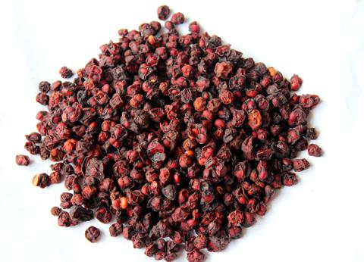
Sour 酸
Function: astringing and arresting discharge (固涩 gu se,收敛 shou lian).
Most of sour herbs are used to treat deficiency syndromes (xu zheng 虚证) or diarrhea.
Fructus Schisandrae （Wu Wei Zi 五味子）

Slide 17
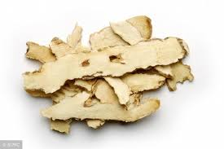
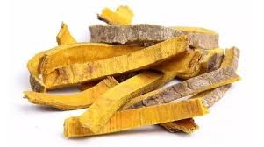
Bitter 苦
Function: draining and drying (xie 泻/泄, zao 燥).
Used for clearing heat (qing re 清热), and draining Fire (xie huo 泻火).
treating constipation
resolving dampness (zao shi 燥湿)
lowering the rebelling Qi (xie jiang qi ni 泄降气逆)
Some bitter substances have the function of preserving Yin (cun Yin 存阴)
Rhizoma Anemarrhenae (Zhi Mu 知母)
Phellodendri (Huang Bai 黄栢)

Slide 18
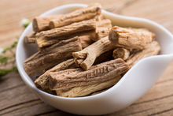
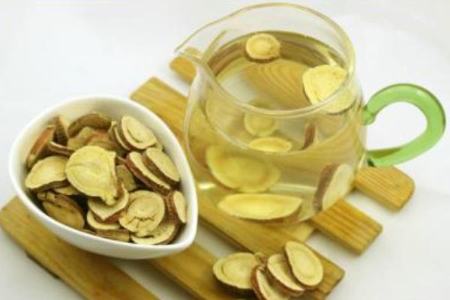
Sweet 甘
Radix Codonopsis (Dang Shen 党参)
Function: regulating middle Jiao (Burner中焦) or relieving pain.
Used to treat deficiency symptoms (xu zheng 虚证) such Qi deficiency.
Radix Glycyrrhizae (Gan Cao 甘草)

Slide 19
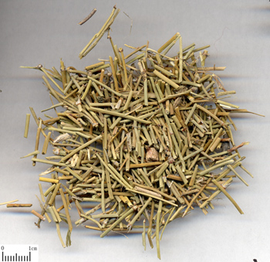
Pungent 辛
Function: dispersing (fa san 发散), promoting Qi and blood circulation (xing qi xing xue 行气行血)
Pungent substances, such as Herba Ephedrae (Ma Huang 麻黄) and Herba Menthae (Bo He 薄荷), are commonly used to treat exterior symptoms (biao zheng 表证).
Herba Ephedrae (Ma Huang)

Slide 20
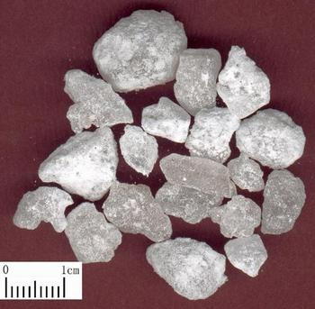
Salty 咸
Function: softening hardness (ruan jian 软坚), soothing sore throats, relieving constipation by draining (xie xia tong bian 泻下通便)
Treatment of Thyroid Neoplasm.
Arcae (Wu Leng Zi 瓦楞子) and Natrii Sulfas (Mang Xiao 芒硝)
Natrii Sulfas (Mang Xiao)

Slide 21
Property and Flavor
Property and flavor are integrative concepts. They work together to define the function of each substance.
Flavor alone is not sufficient to represent the function of the substance. For example, both Huang Lian 黄连 and Sheng Di Huang 生地黄 are cold in property, but Huang Lian is bitter and used for Damp-Heat syndromes while Sheng Di Huang is sweet and used for Yin Deficiency.

Slide 22
(3) Functional Tendency
Refers to the rising, falling, floating, and sinking functions of each substance (升降浮沉)
Substances with rising and floating function move upward and outward, and may have the function of raising Yang, relieving exterior syndromes, or causing resuscitation.
Substances with falling and sinking function move downward and inside, and may have the function of clearing Heat or purgation. They redirect rebellious Qi (qi ni 气逆) to stop vomiting, relieve cough and asthma, and subdue the ascending Yang.

Slide 23
Functional Tendency
The functional tendency of substances is closely related to their properties and flavors, and processing.
Most substances with ascending and floating tendencies are pungent or sweet in flavor and hot or warm in property
Most substances with descending and sinking tendencies are sour, bitter, salty, or astringent in flavor and cold or cool in property.
Functional tendency of substances may be manipulated by processing techniques or combining them with other substances.

Slide 24
(4) Meridian Channel Tropism
Meridian Channel Tropism (Gui jing 归经) refers to a specific effects of substances on certain parts of the body (which divided into different meridian channel systems 经络).
Substances entering the same meridian channel may have different functions.
E.g. Substances enter the Lung channel (Taiyin Lung Channel of Hand 手太阴肺经) but with different applications:
Radix Scutellariae (Huang Qin 黄芩) for clearing Lung Heat
Rhizoma Zingiberis (Gan Jiang 干姜) for warming the Lung
Bulbus Lilii (Bai He 百合) for tonifying the Lung;
Semen Lepidii (Ting Li Zi 葶苈子) for purging the Lung.
Meridian tropism is only part of the therapeutic theory and must be considered along with the tendency, flavor, and the property of the herb.

Slide 25
(5) Toxicity
Some herbal substances can be toxic or slightly toxic.
- may lead to a toxic reaction if an overdose occurs.
- give rise to severe side effects even within a therapeutic dosage.
However, some toxic substances have obvious therapeutic effects.
In order to use these substances properly and safely, the age and constitution of the patients should to be considered carefully as well as the severity and location of the disease.
The dosage of extremely toxic substances should be strictly controlled.

Slide 26
Application of Chinese Medicinal Herbs
Chinese herbs are commonly used in a combination of two or more herbs, called a formula (yao fang 药方), to increase or to reinforce the effects of each medicinal substance, to minimize toxicity or side effects, to accommodate complex clinical situations, and to alter the actions of the substances.
Some general rules for combining herbs:
compatibility
contraindication
dosage

Slide 27
Compatibility
Mutual accentuation: reinforce synergistic effects
Mutual enhancement: one enhances the effect of the other
Mutual counteraction: the toxicity and side effects of one substance are reduced or eliminated by the another substance
Mutual suppression: the substance that reduces or eliminate the toxicity and side effects of another substance
Mutual antagonism: the primary effect of one substance is reduced or eliminated by the other substance
Mutual incompatibility: causes toxic or adverse side effects
Single effect: a single substance that is used to achieve the desired therapeutic effects without any accessory substances

Slide 28
Contraindication (yong yao jin ji 用药禁忌)
There are four types of contraindications or prohibitions in using these substances:
Contraindication to the symptoms
Incompatibility of substances
Contraindication during pregnancy
Dietary incompatibility

Slide 29
Dosage
The common dosage for most of the available substances is 1-3 qian or 3-10 grams.
Variables affecting dosage:
Strength and property of the herbs
Preparation method
Role of the substance in a formula
Severity and duration of the disease
Condition of the patient

Slide 30
Preparation of Herbs
Question: What is the most common form in which traditional herbal medicine is taken? Why?
Decoction (tang, literally “soup”): a preparation of boiling herbs with water or with a proper amount of other solvents, such as wine and vinegar.
Decoctions are liquid extractions of the herbs that are absorbed easily in the human body.
The contents of a decoction are easily changed to fit clinical needs.
Details for preparation process of a decoction: refer to pg. 25-27 of the book Illustrated Chinese Materia Medica

Slide 31
Substance Administration
Decoctions are usually taken warm. Those for expelling Wind-Cold patterns are better taken while hot.
Tonics should be taken before meals.
Substances irritating to the stomach and intestines should be taken after meals.
Anthelminthics and purgatives should be taken on an empty stomach.
Sedatives and tranquilizers should be taken before bedtime.
For the substances taken before or after meals, there must be a one- to two-hour interval between the meal and the medicine to prevent the interference on the therapeutic effect from the food.

Slide 32
GROUP WORK

Slide 33
Analyzing a herb therapy:
Analyze the property, flavor, channel tropism and function of the medical substances based on the Illustrated Chinese Materia Medica.
Tell the overall function of the therapy and explain the reasons of your judgement by using the theory of TCM, such as the theory Yin-Yang, the theory of five elements and five organs, and the theory of Chinese herb, etc.
You will be provided with a herb formula. Please follow the instructions in the right column.

Slide 34
Ren Shen 人参 3-9g
Bai Zhu 白术 3-12g
Fu Ling 茯苓 3-15g
Gan Cao 甘草 1.5-6g
Shu Di Huang 熟地黄 3-18g
Bai Shao 白芍 3-15g
Dang Gui 当归 3-15g
Chuan Xiong 川芎 3-9g
Sheng Jiang 生姜 1-3g
Da Zao 大枣 1.5-5g
Analyze the property, flavor, channel tropism and function of the medical substances based on the Illustrated Chinese Materia Medica.
Tell the overall function of the therapy and explain the reasons of your judgement by using the theory of TCM, such as the theory Yin-Yang, the theory of five elements and five organs, and the theory of Chinese herb, etc.

Slide 35
THANK YOU!
Reference for the herb therapy:
https://www.americandragon.com/Herb%20Formulas%20copy/BaZhenTang.html

